Slide 1
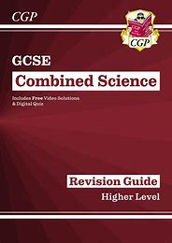
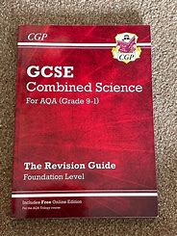
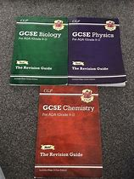
The Nether Stowe Revision Programme
Science
Where can I find revision materials? | How do I know what to revise first?
Revision materials will be on your Showbie Class. Useful websites: Physicsandmathstutor.co.uk BBC Bitesize. https://www.bbc.co.uk/bitesize/examspecs/zpgcbk7 https://www.youtube.com/@ScienceShorts https://www.youtube.com/@ScienceShorts https://www.youtube.com/@Cognitoedu | Revise those topics which were taught at the start of GCSE. So for week 1 revise Biology B1(Cell structure and transport), Chemistry C1(Atomic structure) and Physics P1 (Conservation and dissipation of Energy). Then follow the revision guide for weeks 1-8.
Where can I find practice questions to try? | How should I revise science?
Physicsandmathstutor.co.uk Your teachers will also put past paper questions onto your Showbie class. | 1.Make revision notes/mind maps on each of the topics (e.g. B1). 2.Learn you revision notes/mind maps. 3. Without using your revision notes/mind maps write down what you can recall from memory. 4. Look at your revision notes/ mind maps to identify what you could not recall. 5. Learn what you could not recall. 6. Do past paper questions on the topic that you have learnt.
Possible revision guides

Slide 2
The Nether Stowe Revision Programme
Subject: Science
Week | Biology | Chemistry | Physics
1 | B1 Cell structure and transport. | C1. Atomic structure | P1. Conservation and Dissipation of energy
2 | B2. Cell Division. | C2. The periodic table | P2. Energy transfer by heating.
3 | B3. Organisation and digestive system. | C3. Structure and bonding. | P3. Energy resources.
4 | B4. Organising animals and plants. | C4. Chemical calculations. | P4. Electric circuits.
5 | B5. Communicable disease. | C5. Chemical Analysis. | P5. Electricity in the home.
6 | B6. Preventing and treating disease. | C6. Electrolysis | P6. Molecules and Matter.
7 | B7. Non-communicable disease. | C7. Energy transfers. | P7. Radioactivity
8 | B8. Photosynthesis. | C8. Rates and Equilibrium | P8. Forces in balance.

