Slide 1
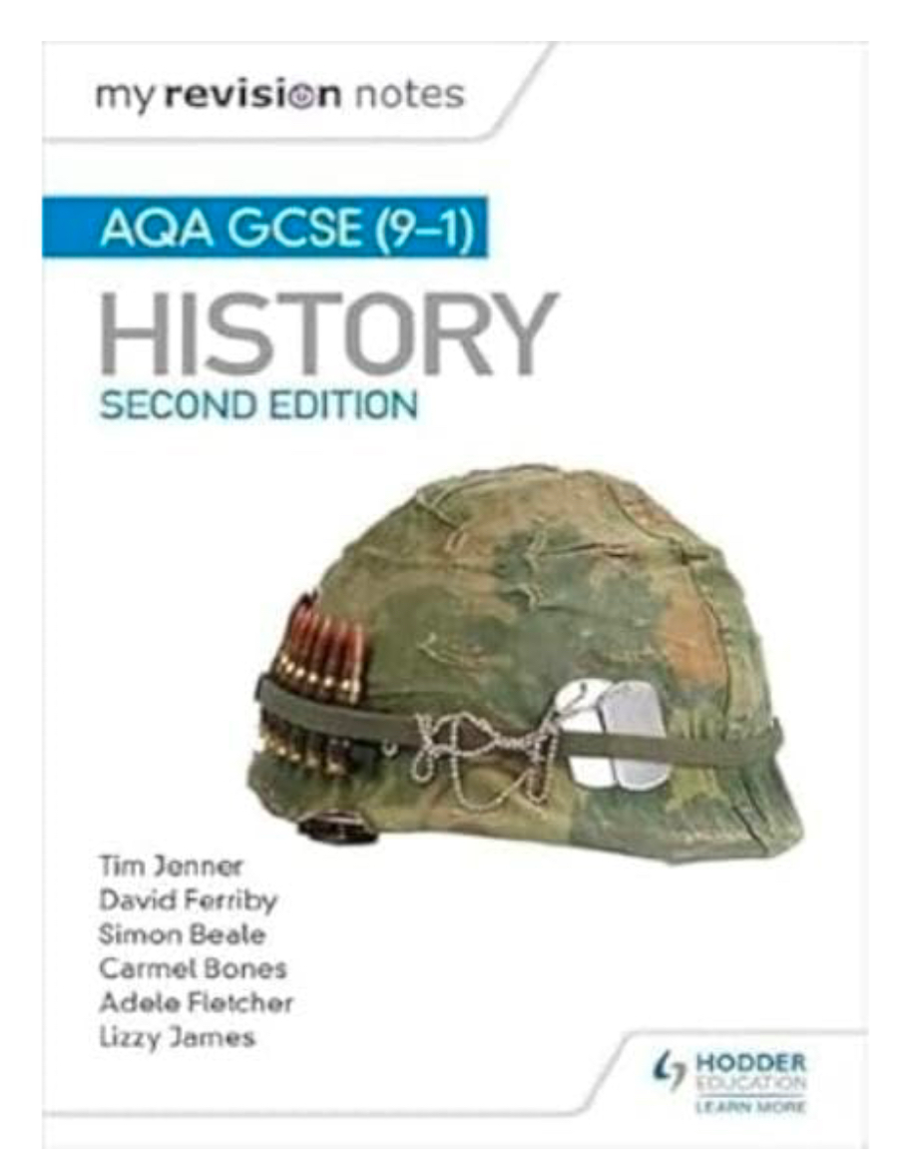
The Nether Stowe Revision Programme
HISTORY
Where can I find revision materials? | How do I know what to revise first?
Seneca Learning - this has revision for all four modules - American Expansion, Health and the People, Norman England and Conflict and Tension in Asia. Showbie History Revision group | Start off with the content which we covered at the beginning of Y10 – American Expansion.
Where can I find practice questions to try? | How should I revise history?
Click here – this will take to the AQA History website. Your modules are: AA America, 1840-1895 Expansion and consolidation BD Conflict and Tension in Asia, 1950-1975 AA Britain: Health and the People c1000 to the present day BA Norman England, c1066-1100 | Mindmaps – This link here will give you some key tips and guidance. Flashcards – This link here will give you some key tips and guidance.
Possible revision guides

Slide 2
The Nether Stowe Revision Programme
HISTORY
Week | Topic 1 | Topic 2 | Topic 3
1 | American Expansion: Great Plains | Health and the People: Hippocrates and Galen | Norman England: Anglo-Saxon England
2 | American Expansion: Pioneers | Health and the People: Medieval surgery | Norman England: Battle of Gate Fulford
3 | American Expansion: Mormons | Health and the People: Medieval Public Health | Norman England: Battle of Stamford Bridge
4 | American Expansion: Causes of the Civil War | Health and the People: Medieval beliefs causes of disease | Norman England: Preparations for Hastings
5 | American Expansion: Impact of the Civil War | Health and the People: Renaissance surgery | Norman England: Battle of Hastings
6 | American Expansion: Homesteaders | Health and the People: Renaissance Public Health | Norman England: Aftermath of Hastings
7 | American Expansion: Plains Indian life | Health and the People: Renaissance causes of disease | Norman England: William’s methods of control
8 | American Expansion: Battle of Little Big Horn | Health and the People: Renaissance surgery | Norman England: Domesday Book

