Slide 1
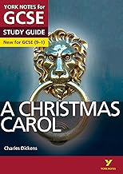
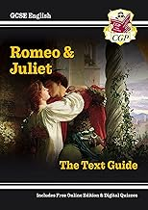
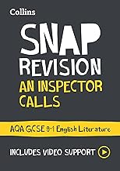
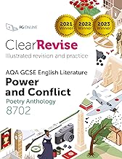
The Nether Stowe Revision Programme
English Literature
Where can I find revision materials? | How do I know what to revise first?
Go back to previous lessons on showbie. Search for the texts we have studied on Seneca - make sure you choose AQA versions. Visit Mr Bruff's youtube channel and search for videos for our texts. | Start with Paper 1 texts: A Christmas Carol Romeo and Juliet Before moving onto Paper 2: Unseen Poetry An Inspector Calls Power and Conflict Poetry
Where can I find practice questions to try? | How should I revise English Literature?
AQA | English | GCSE | GCSE English Literature Worksheets - MrBruff.com - choose the texts we have studied. | Practise answering sample questions. Reading the texts and watch the films (make sure you look for the differences between the film and real text!) Annotate extracts / watch annotation videos. Create flash cards for quotations and test yourself. R&J film / full text ACC film / full text AIC film / full text
Possible revision guides:
These brands are available for all of the texts we study, which you choose is personal preference!

Slide 2
The Nether Stowe Revision Programme
Subject: English
Week | Topic 1 | Topic 2 | Topic 3
1 | Language Paper 1 Reading | A Christmas Carol | Read widely. Practise timed writing.
2 | Language Paper 1 Writing | Romeo and Juliet | Read widely. Practise timed writing.
3 | Language Paper 2 Reading | An Inspector Calls | Read widely. Practise timed writing.
4 | Language Paper 2 Writing | Power Poetry | Read widely. Practise timed writing.
5 | Language Paper 1 Reading | Unseen Poetry | Read widely. Practise timed writing.
6 | Language Paper 1 Writing | Romeo and Juliet | Read widely. Practise timed writing.
7 | Language Paper 2 Reading | A Christmas Carol | Read widely. Practise timed writing.
8 | Language Paper 2 Writing | Conflict Poetry | Read widely. Practise timed writing.

