Slide 1
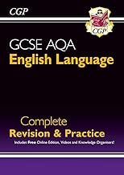
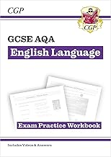
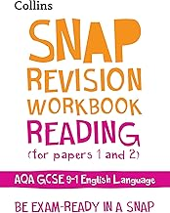
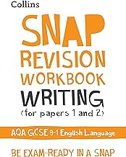
The Nether Stowe Revision Programme
English Language
Where can I find revision materials? | How do I know what to revise first?
Go back to previous lessons on showbie. Search for AQA English Language on Seneca Visit Mr Bruff's youtube channel. | Start with paper 1 before moving on to paper 2 but remember, skills and practise are more important than knowledge/ content for these exams!
Where can I find practice questions to try? | How should I revise English Language?
AQA | Resources | Past Papers & AQA Mark Schemes Mr Bruff sheets and videos | Practise answering sample questions. Reading widely. Engage in current events by watching, reading and discussing the news. Practise creative writing and checking for accuracy. Practise timed writing.
Possible revision guides:
Many others are available, just make sure they are suitable for AQA.

Slide 2
The Nether Stowe Revision Programme
Subject: English
Week | Topic 1 | Topic 2 | Topic 3
1 | Language Paper 1 Reading | A Christmas Carol | Read widely. Practise timed writing.
2 | Language Paper 1 Writing | Romeo and Juliet | Read widely. Practise timed writing.
3 | Language Paper 2 Reading | An Inspector Calls | Read widely. Practise timed writing.
4 | Language Paper 2 Writing | Power Poetry | Read widely. Practise timed writing.
5 | Language Paper 1 Reading | Unseen Poetry | Read widely. Practise timed writing.
6 | Language Paper 1 Writing | Romeo and Juliet | Read widely. Practise timed writing.
7 | Language Paper 2 Reading | A Christmas Carol | Read widely. Practise timed writing.
8 | Language Paper 2 Writing | Conflict Poetry | Read widely. Practise timed writing.

