Slide 1
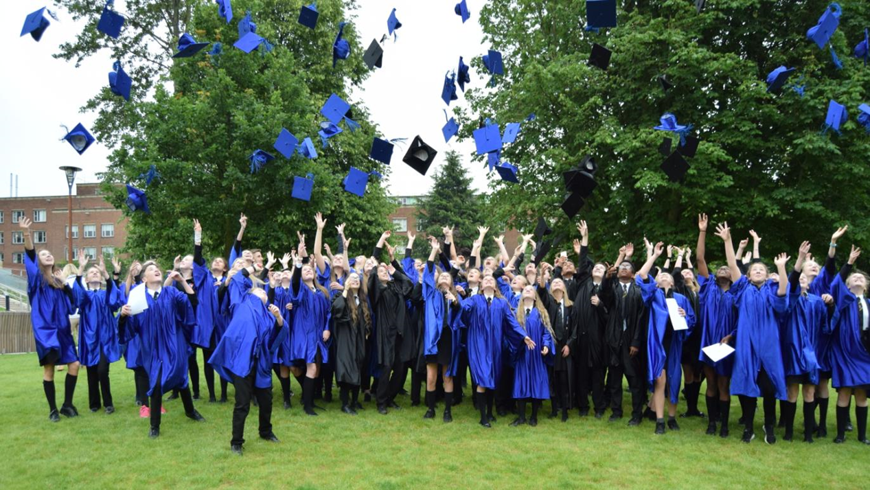

Slide 2
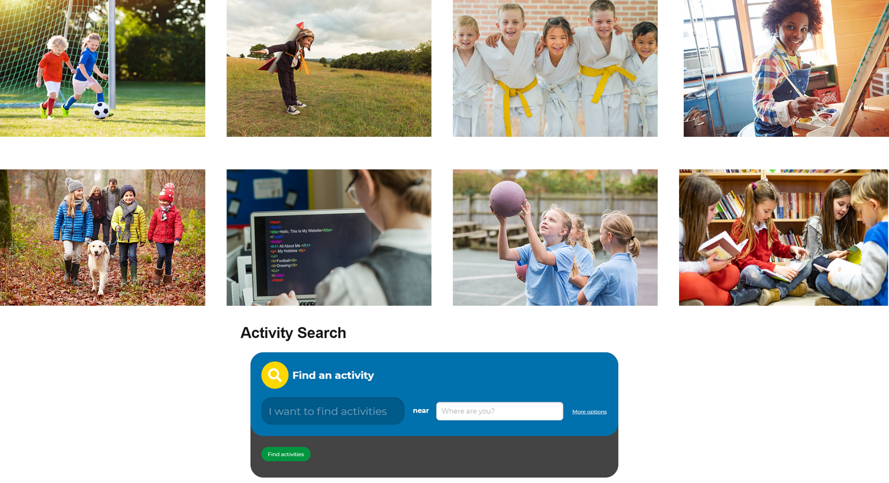
How can you earn your hours?
You earn your hours when you take part in any kind of learning activity outside the classroom.
It could be a club you attend run by school, or even not attached to school. It can be activities provided by the different subject areas across school.

Slide 3
You can also earn hours by attending nationally provided learning opportunities across the UK.
9

Slide 4
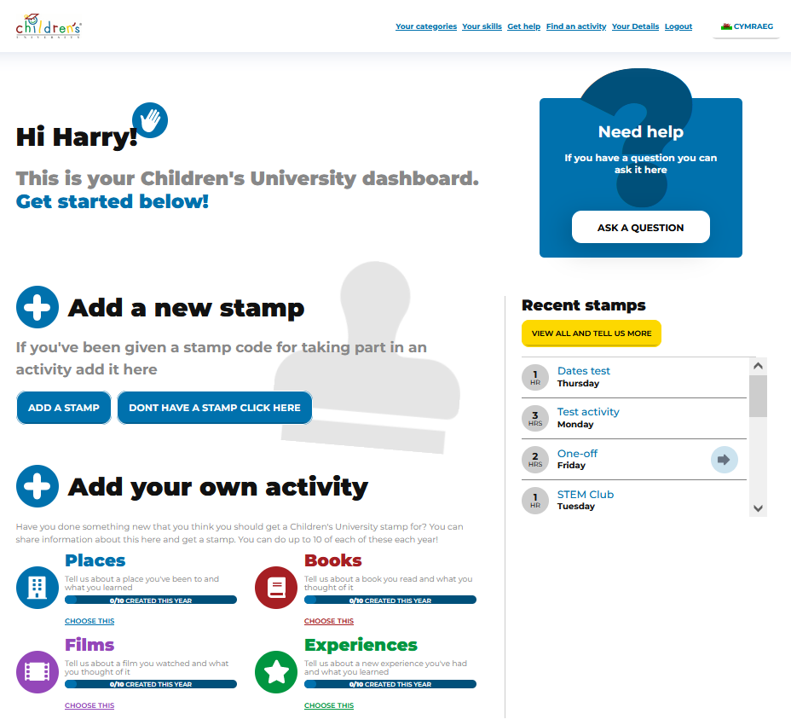
Logging your hours
For every activity you do you collect a stamp code which you simply type in on your online account.
You can also add your own activity, for example if you went somewhere on holiday and learnt about a new place.

Slide 5
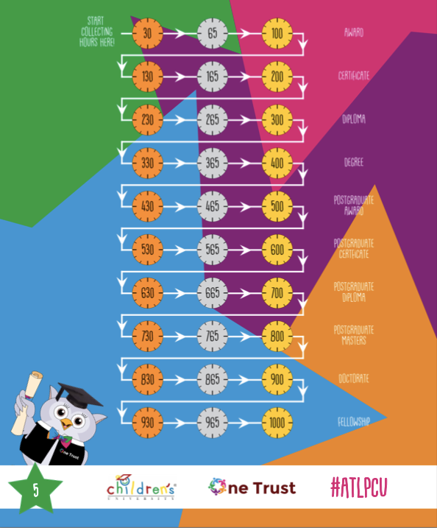
graduations
Bronze Graduations = 30 hours in college celebration assembly
Silver Graduation = 65 hours in college celebration assembly
Gold Graduation = 100 hours celebration event in school alongside college winners

Slide 6
Why take part?
Feel that you have grown in confidence and self-belief.
Enjoy new experiences, in new places and that you want to keep exploring.
Believe that you have a broader range of essential skills.
Feel empowered to make positive choices about your future.
For you to see that learning is fun, aspirational and lifelong.
Feel that your eyes have been opened to lots of learning activities and opportunities.
Feel that you are celebrated for the commitment to learning by your family and school.

Slide 7
Validating activities outside of school
If you attend a club outside of school you can use the hours of activity from that as well, simply pick up a registration postcard from Miss Rose and take it to your out of school club. They then have to complete a short registration activity and a stamp code will be created for them to share with you when you attend.

